Slide 1
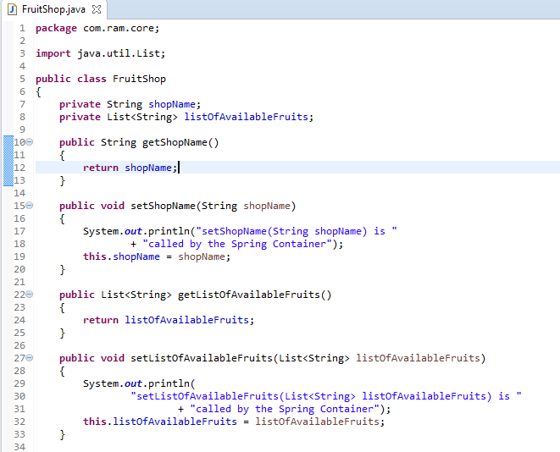
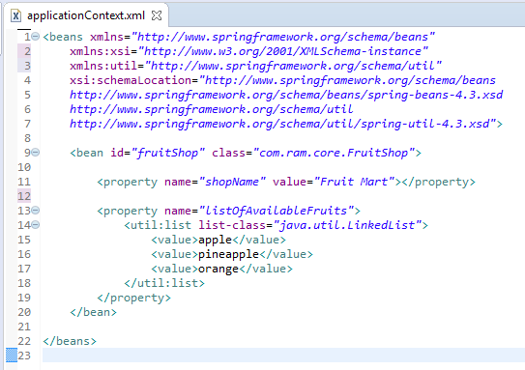
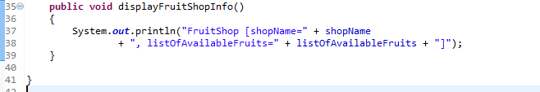
<util:list> to create a concrete List collection class (ArrayList and LinkedList)
We can use <util:list> to create a concrete List collection class (ArrayList and LinkedList) in Spring’s bean configuration file.
<util:list> will instantiate an LinkedList at runtime, and inject it into a bean property.

Slide 2
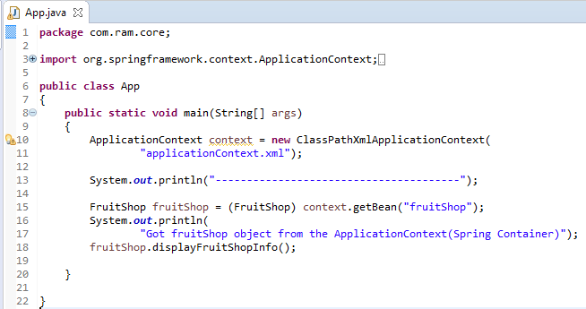
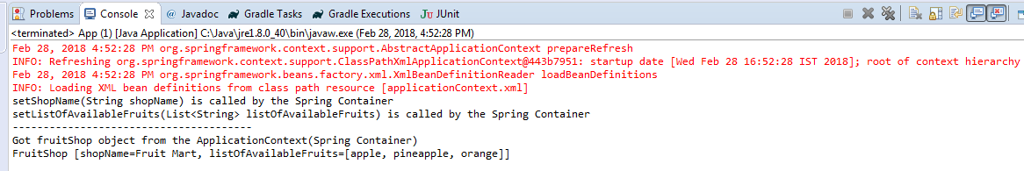
<util:list> to create a concrete List collection class (ArrayList and LinkedList)

